Slide 1
Vinda Store Annual Report
Objective: Vrinda store wants to create annual sales report, so that store can understand its customers and grow more sales in the upcoming year.

Slide 2
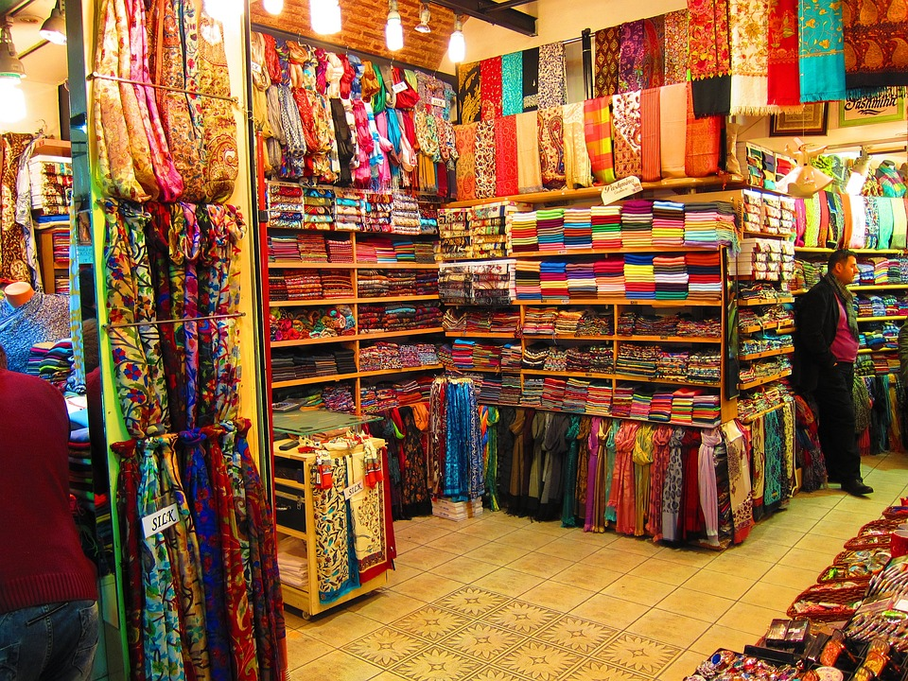
Sample Insights:
Women are more likely to by compared to men. (~65)
Maharashtra, Karnataka and Uttar Pradesh are top 3 states. (~35%)
Adult age group (39-40 yrs.) is max contributing (~50)
Amazon, Flipkart and Myntra are max contributing channels. (~80%)
Conclusion to improve Vrinda stores sales:
Target women customers of age group (30-49yrs) living in Maharashtra, Karnataka and Uttar Pradesh by showing add/offer/coupons available on Amazon, Flipkart and Myntra.

